Slide 1
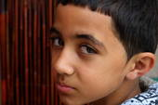
Walk in the Shoes of Your English Language Learners
Costa Rica Study Away
3 ½ week summer intersession
4 cr. EEM597 or 607 required
1cr. EEM596 &/or 1 cr. UHC396 additional credit options

Slide 2
Have you ever been the language and/or cultural minority?
What was it like?
How did it feel?
What helped you become comfortable?
What didn’t help?
https://www.youtube.com/watch?v=-chrxDVqlhE&feature=share

Slide 3
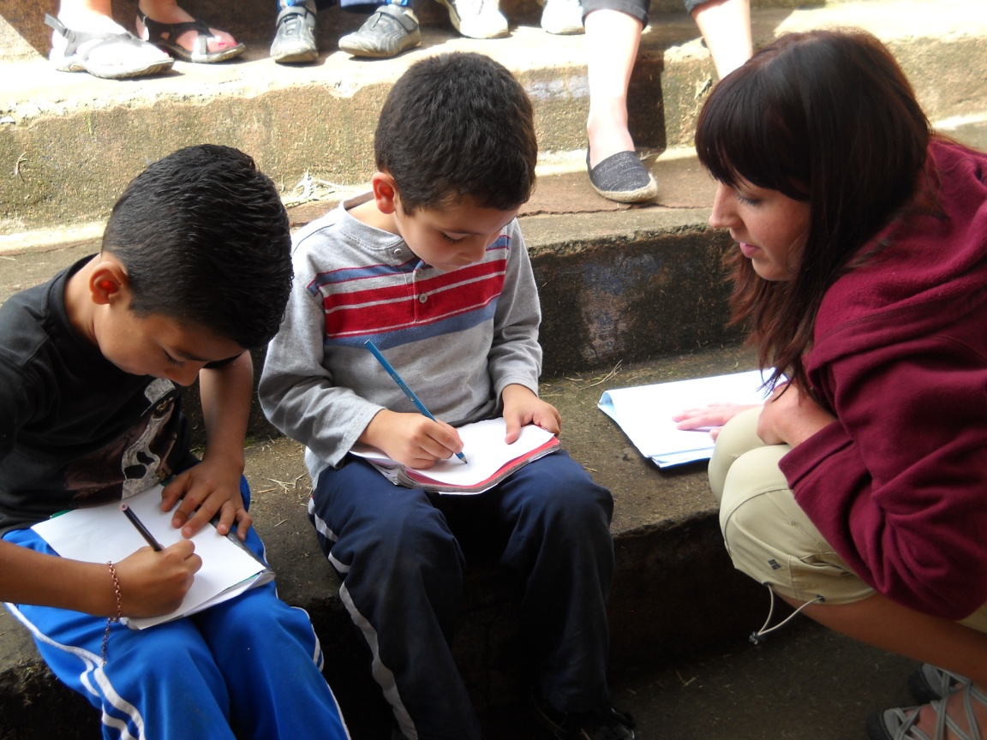
Purpose of the course/trip:
To engage with culturally different others and understand how children and their families, for whom English is not their first language, feel when they come to our schools and classrooms where everything, including content learning, is in English.
How can you help all your students be successful in school?

Slide 4
Costa Rica: A Trip of a Lifetime!

Slide 5
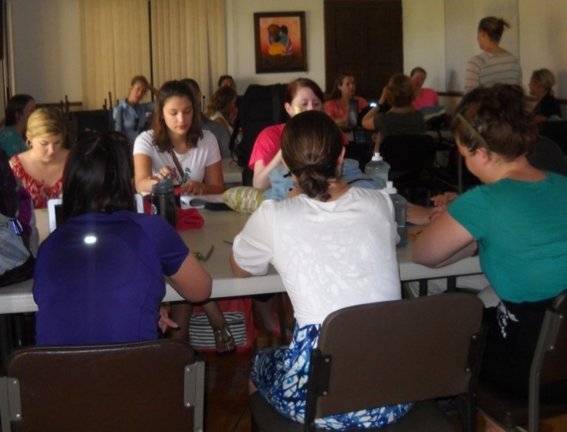
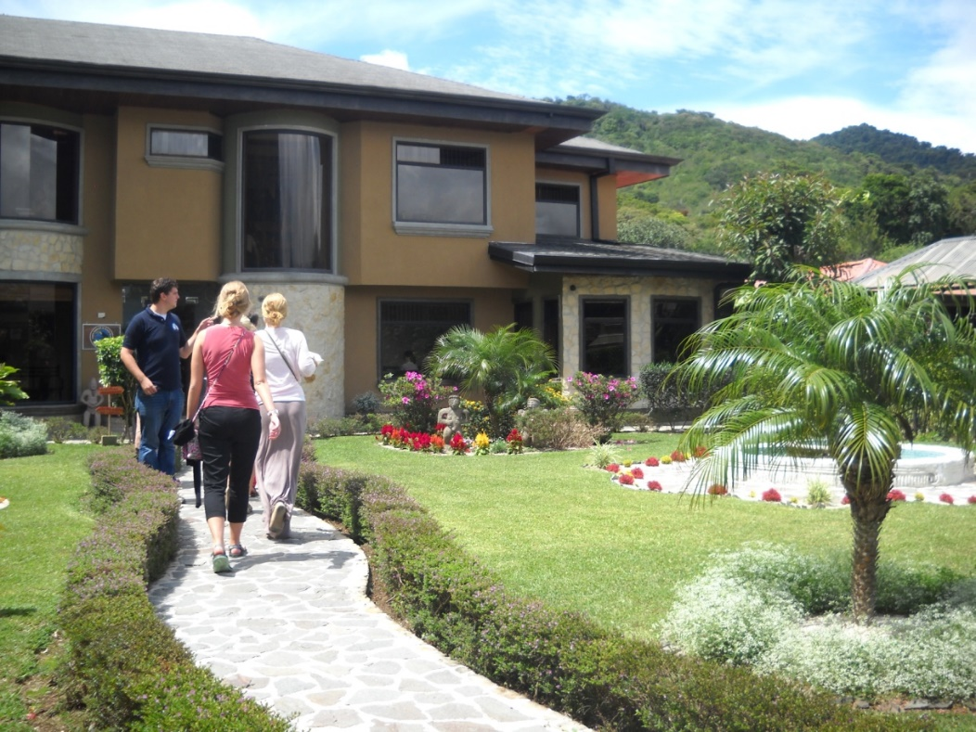
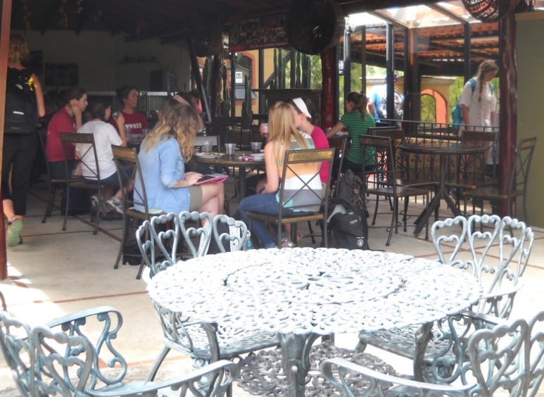
in Heredia a typical town
Learn Spanish with Centro Panamerican de Idioma (CPI)
Spanish Immersion School
in Monteverde
the cloud forest

Slide 6
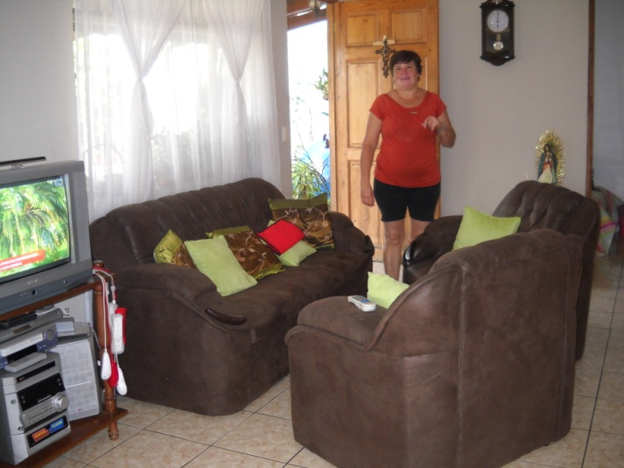
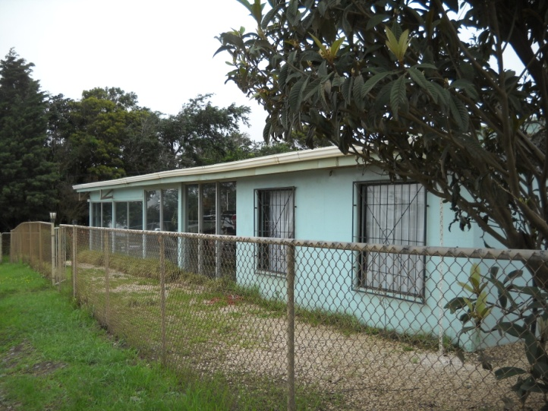
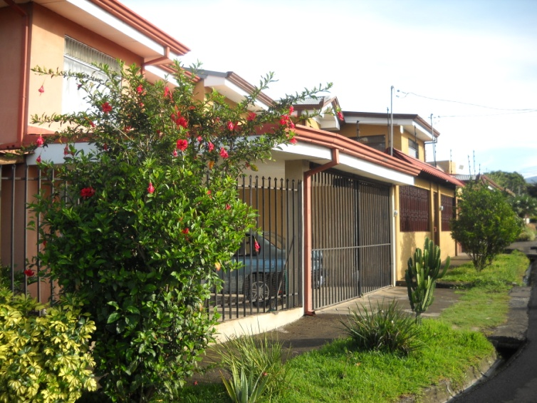
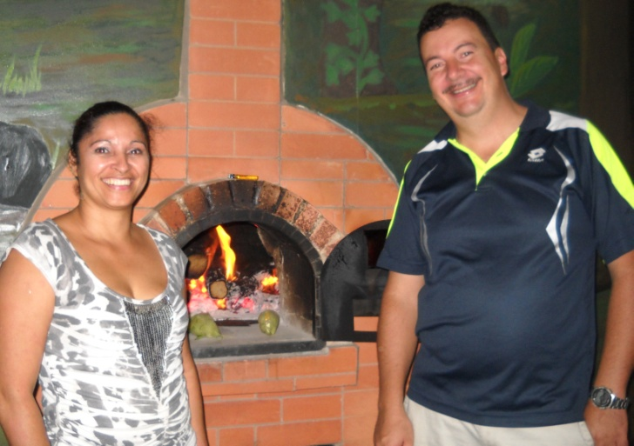
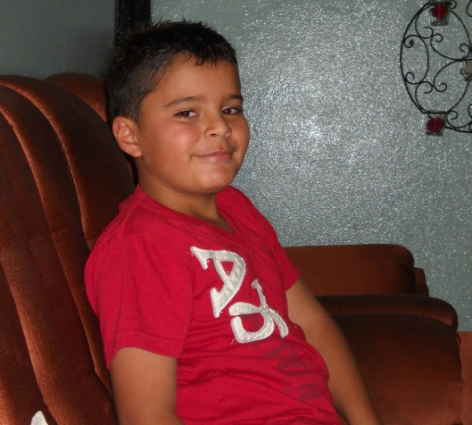
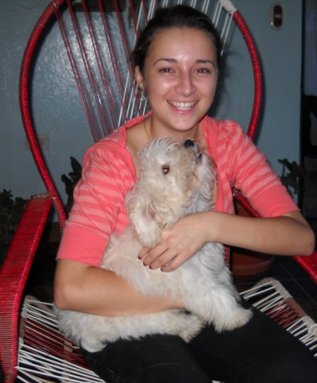
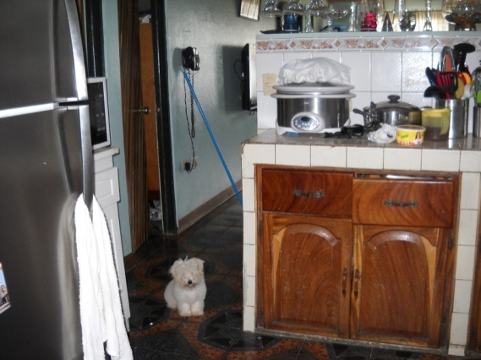
Live with local families; join in their activities
at home and in the neighborhoods that are as varied as ours in the US.
Learn how to communicate with non-English speakers!

Slide 7
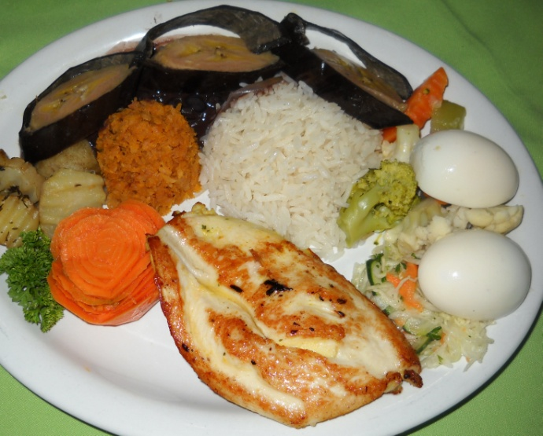
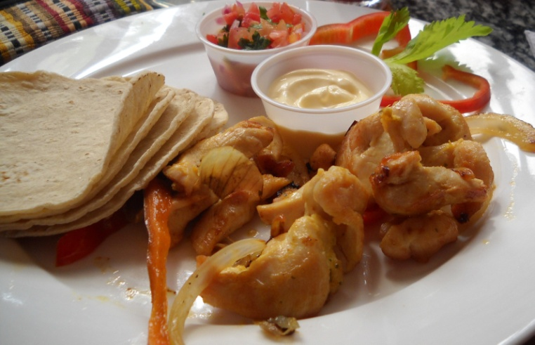
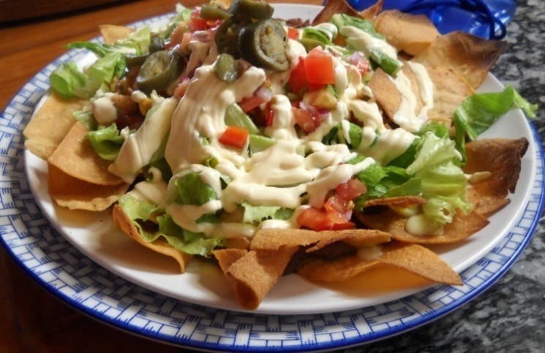
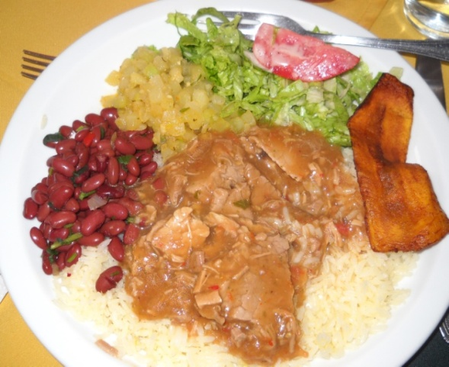
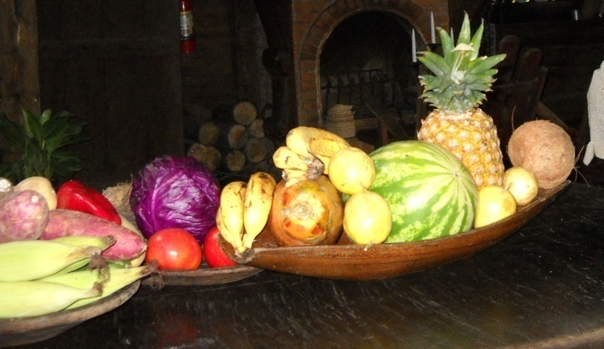
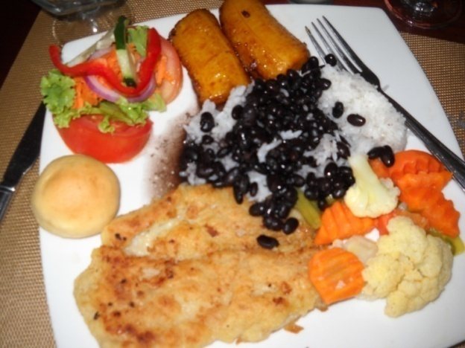
Enjoy all kinds of Costa Rican cuisine.

Slide 8
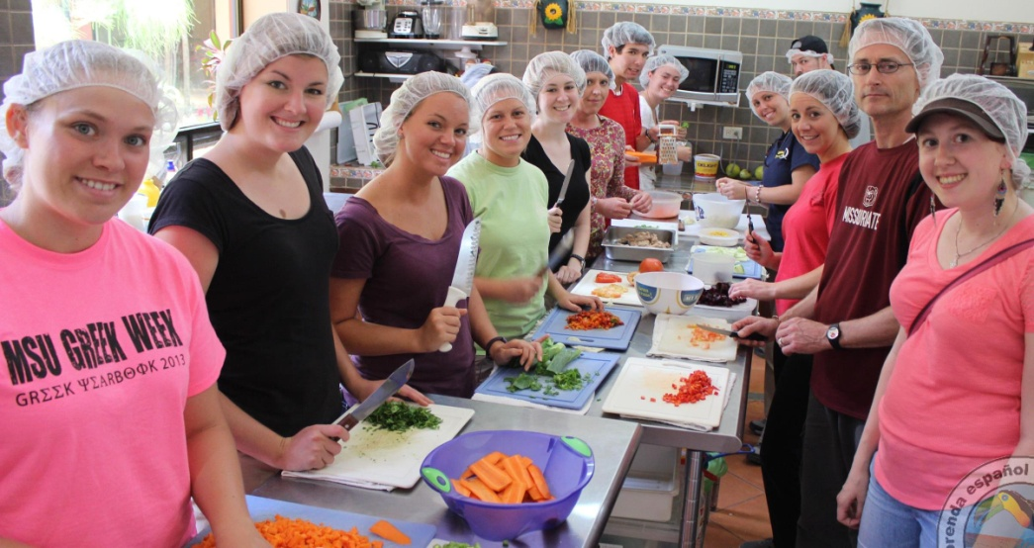
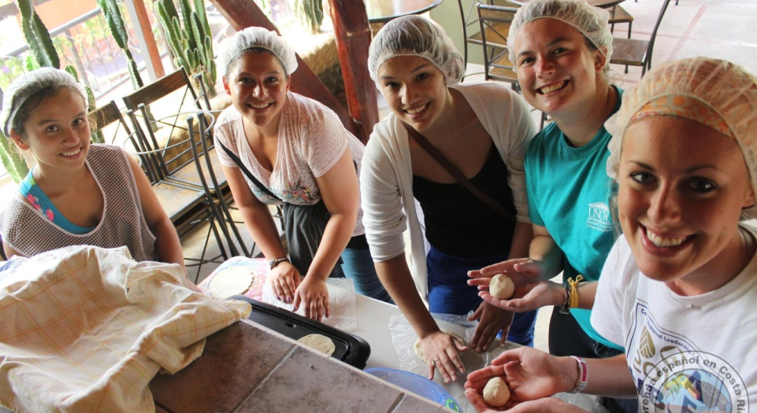
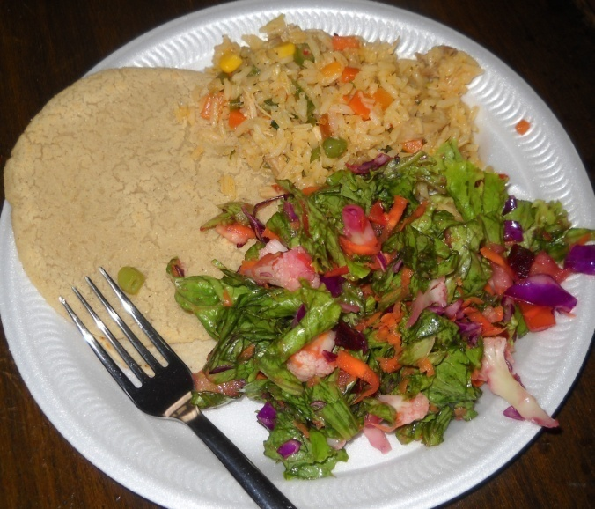
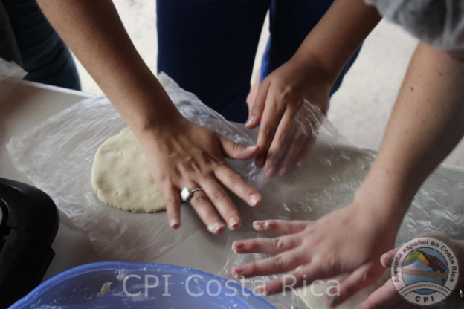
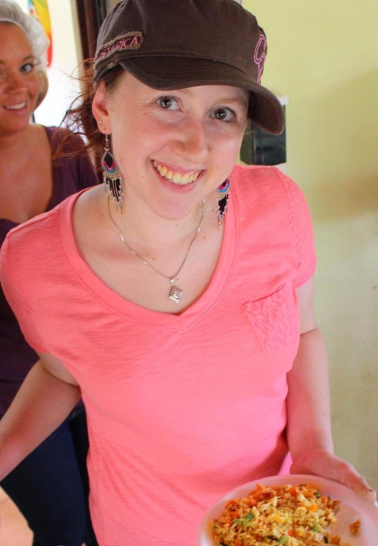
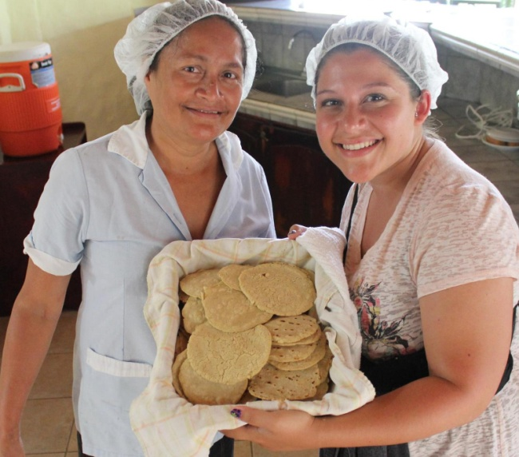
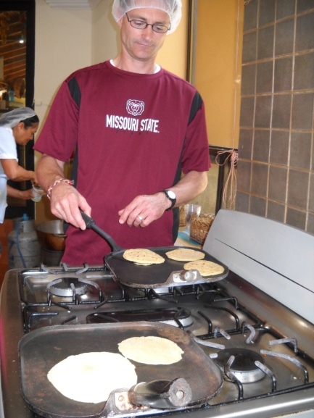
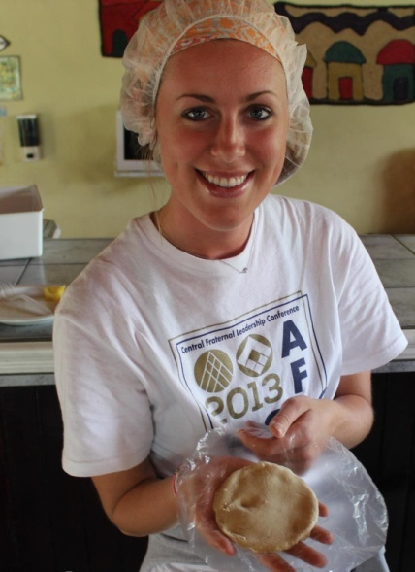
Learn to cook
Latin dishes.

Slide 9
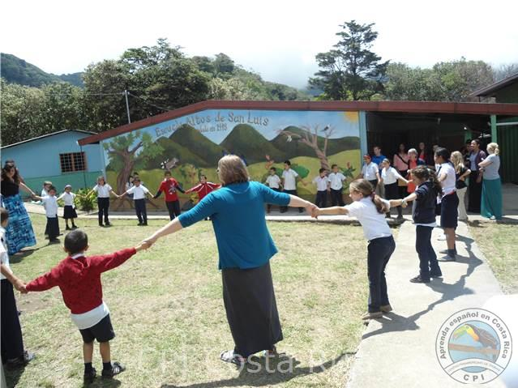
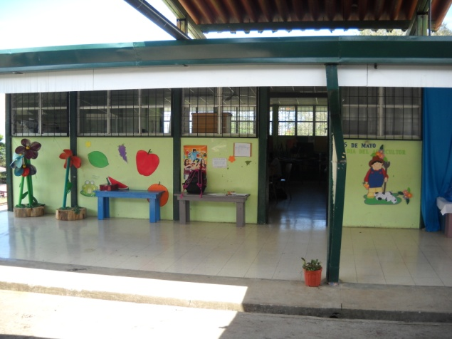
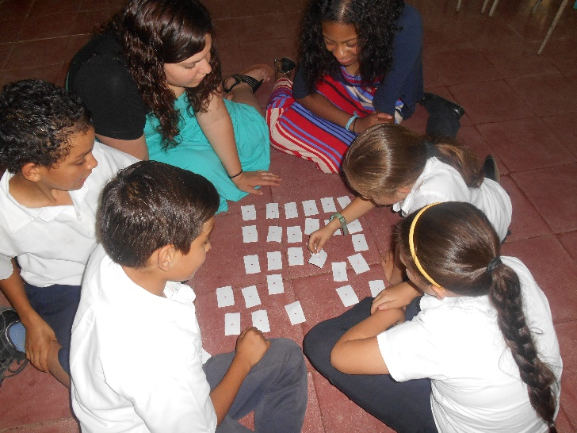
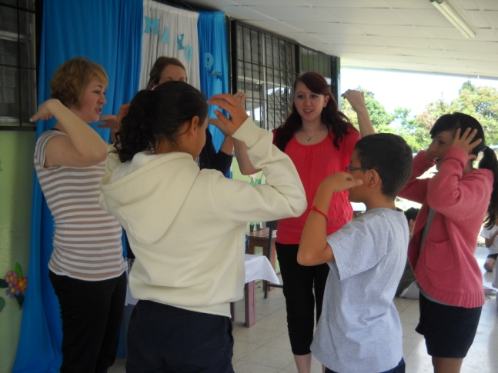
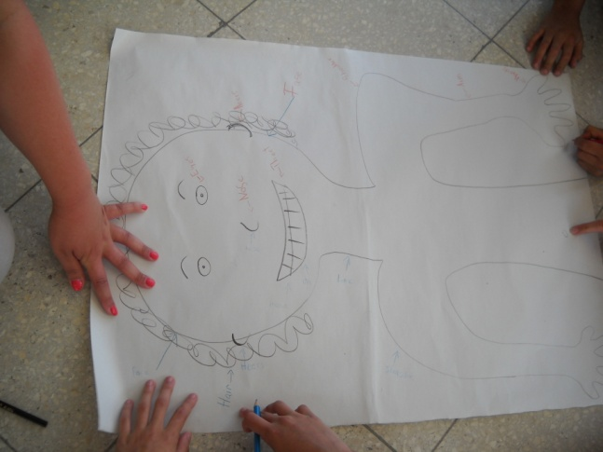
Teach English lessons in local elementary schools

Slide 10
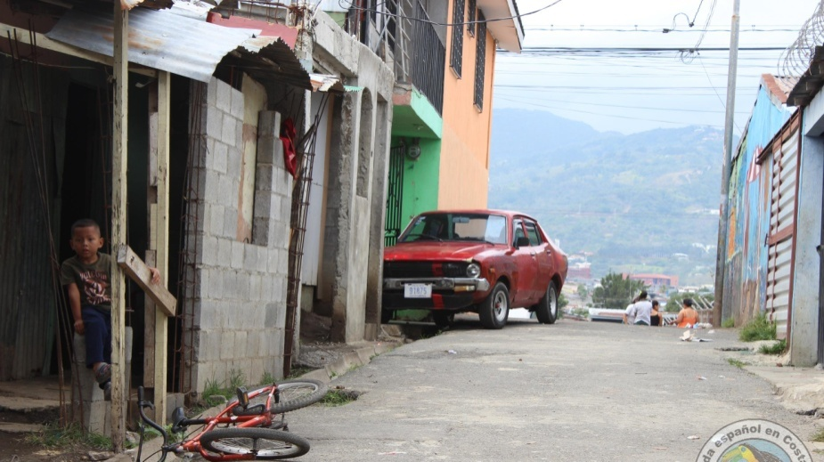
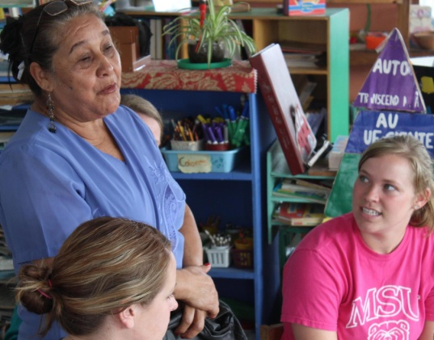
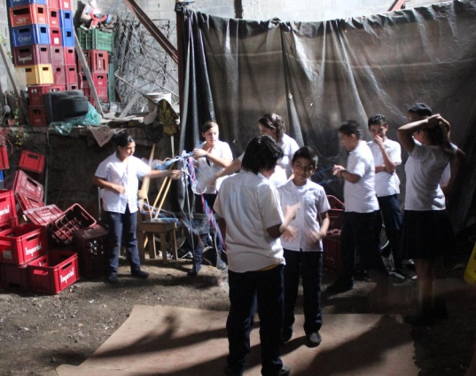
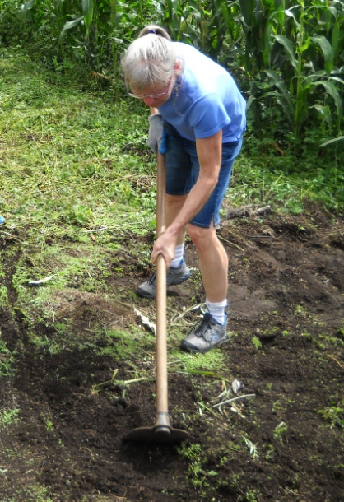
Take part in service learning projects-
--- in a Nicaraguan refugee community outside the Costa Rican capitol city of San Jose .
--- on a coffee farm using traditional tools and practices to plant trees offsetting our carbon footprint.

Slide 11
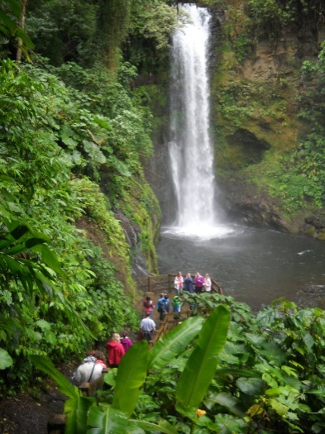
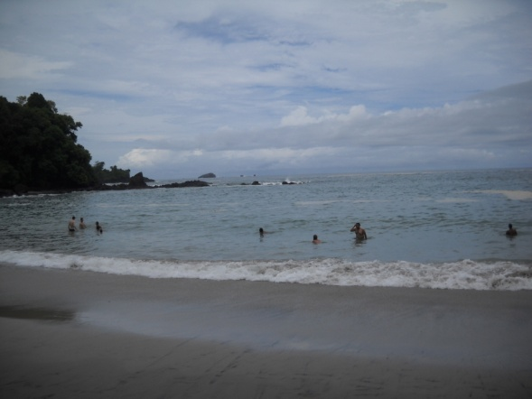
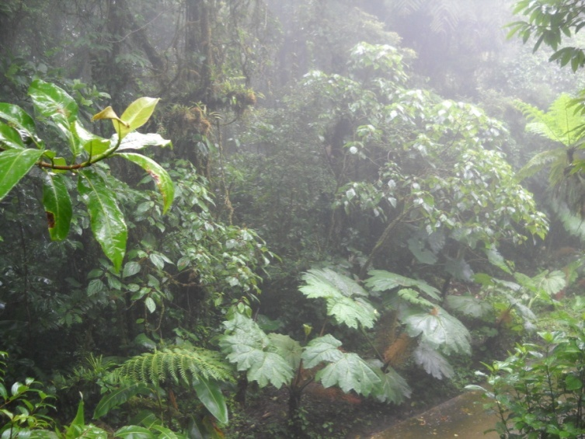
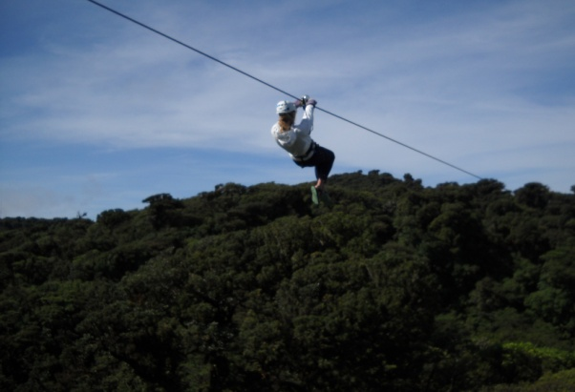
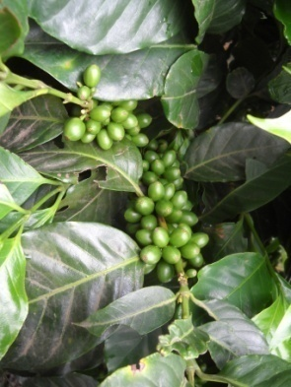
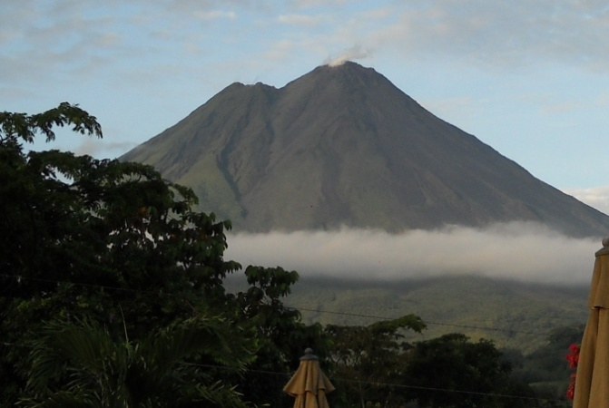
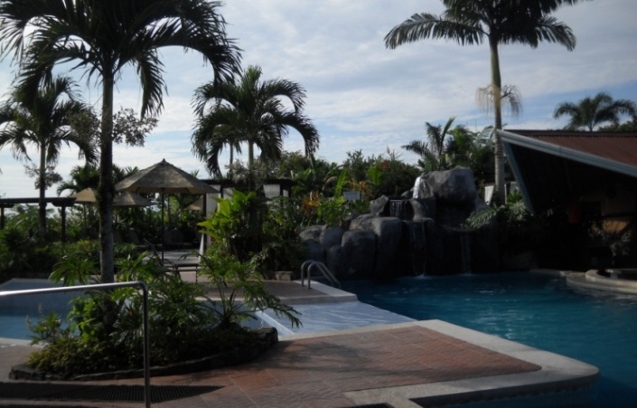
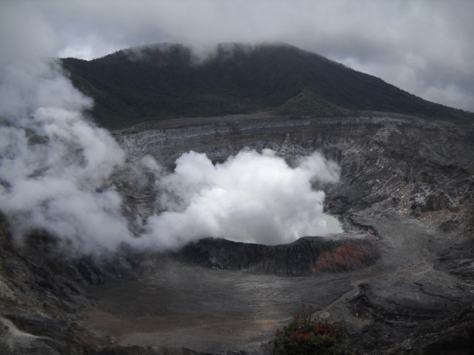
Experience the splendor of Costa Rica
(It is not all work and no play!)
Manual Antonio
National Park Beach
La Paz
Waterfall Garden
El
Trapiche
Coffee
Farm
St. Elena Cloud Forest Reserve
Zip lining in Monteverde
Arenal Volcano & Hot Springs
Poas Volcano
National Park

Slide 12
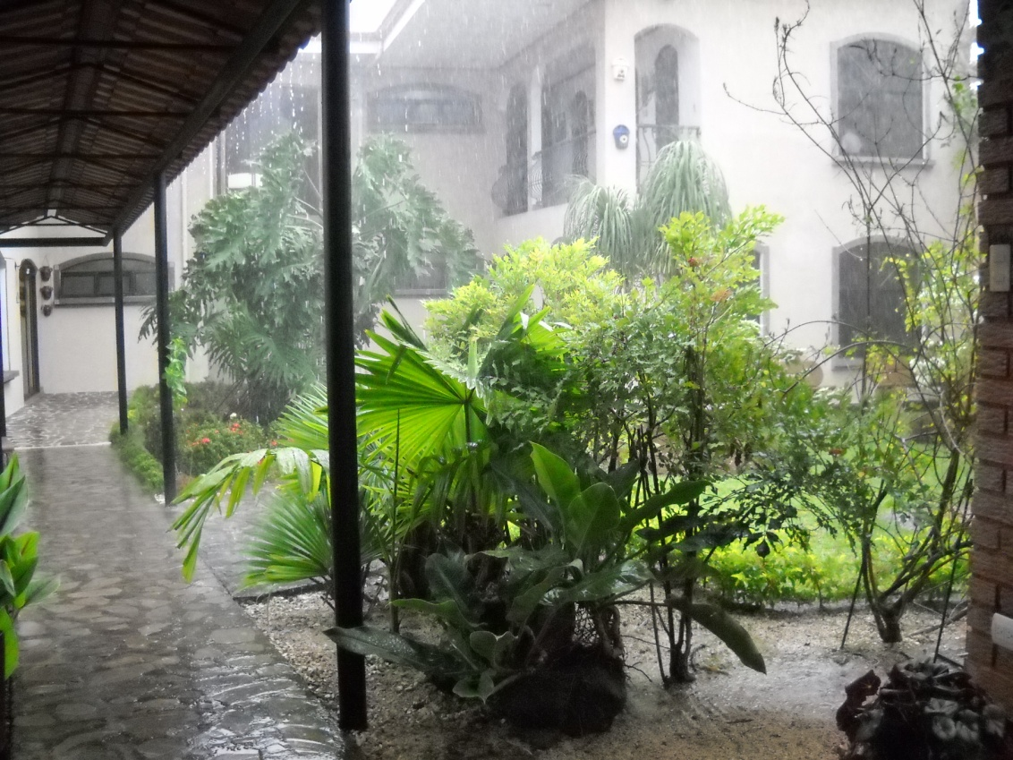
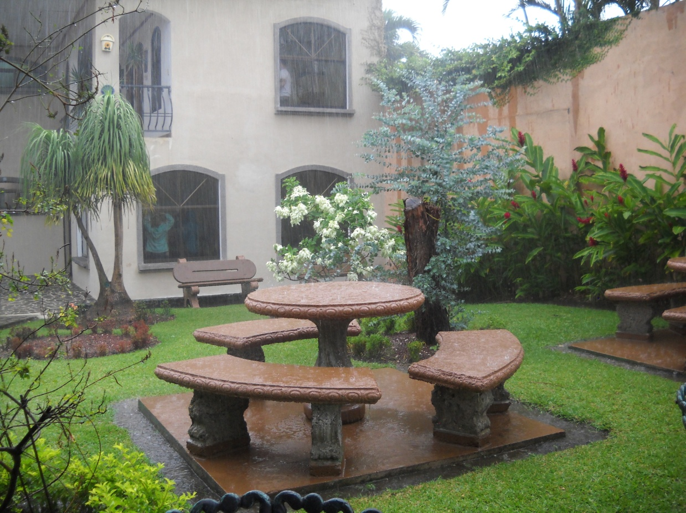
Get wet in Costa Rica
After all, it IS a tropical country!

Slide 13
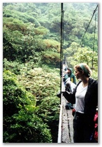
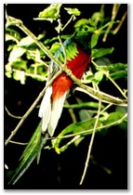
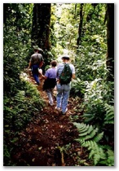
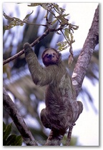
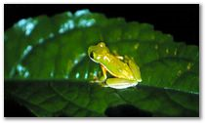
See common and rare mammals, birds, insects and plants in Costa Rica---one of the most diverse wildlife refuges in the New World Tropics.

Slide 14
Sample local and big city shopping in Costa Rica.

Slide 15
Program Fee
Includes: Roundtrip airfare, all ground transport, lodging, meals (except 10 lunches/snacks), entrance fees and Spanish classes, Study Away student fee and international medical insurance.
Excludes: Passport, MSU tuition, 10 lunches, incidentals/ miscellaneous personal expenses, snacks, and souvenirs.

Slide 16
Application Due: December 1 (rolling admission---applicants will be notified of acceptance into the program within a week of completing the application.)
Maximum enrollment: 15
Apply online on MSU’s Study Away website

Slide 17
Scholarship Eligibility & Financial Aid
Students may apply for the College of Education Study Away scholarship at: http://missouristate-sa.terradotta.com/index.cfm?FuseAction=Programs.ViewProgram&Program ID=10829. (Study Away College Scholarship page on Study Away website-- Financial Considerations link)
Scholarship application due November 1. (You must be accepted into the program for your scholarship application to be considered on November 1.)
Students who receive financial aid may apply those funds to this program.
Contact the Office of Financial Aid at 836-5262
for more information.

Slide 18
Interested?
Contact:
Dr. Roberta Aram
robertaaram@missouristate.edu
Find out what students have to say about Costa Rica by reading their photo blogs on the CEFS website.

